Slide 1
WELCOME TO HYLAND!
Notes:
Hello and Welcome! We are so exacted to be here with you all today. My name is Marissa. I’ve been at Hyland for about a year! I’m the Project Manager of the Tech Outreach team. The Tech Outreach Team puts together programs like this to help introduce students to coding and computer science through different events, workshops and programs. I’m going to let my coworker Joseph introduce himself!

Slide 2
TABLE OF CONTENTS
01
02
03
04
What We Do
Who We Are
You + Hyland
Questions!
Notes:
Today I’m going to talk about what it is that Hyland does, who we are as a company and employer and opportunities we have for middle school students like you!

Slide 3
01
WHAT WE DO
Hyland + our products
Notes:
First I’m going to talk about Hyland, what we do and what products we offer

Slide 4

What We Do
Hyland + our products
How many of you have heard of Hyland before today?
Does anyone have examples of software they use?
Example!
Notes:
How many of you have heard of Hyland before today?
Does anyone have examples of software they use?
Laptop: hardware, Microsoft PPT is considered software

Slide 5
Hyland is a software development company that creates software products that help companies do their business in an easier way.
Notes:
Hyland is a software development company that creates software products that help companies do their business in an easier way.
To further introduce Hyland and what we do, I’d like to start off with a quick video (click to next slide, then press play on the screen)

Slide 6

ABOUT HYLAND

Slide 7

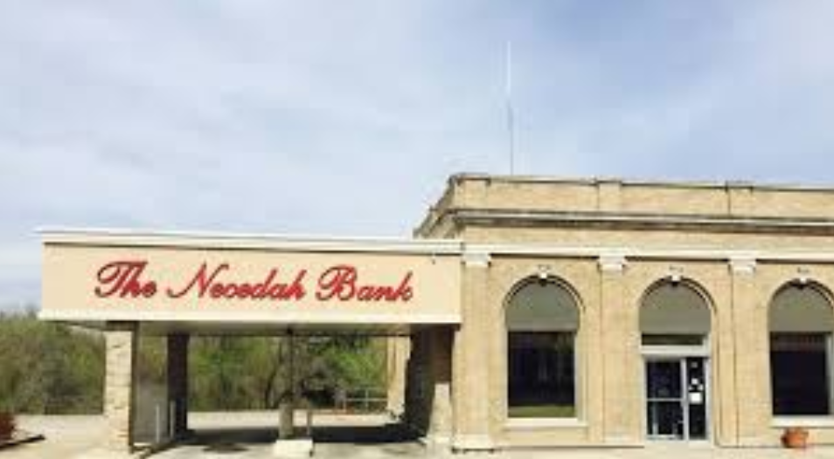


HELP!
Notes:
After the video- ask the students to tell you some of the things that stood out to them
It all started in 1991 when a bank in Necedah (NUH- SEE-DUH), Wisconsin was looking for a better way to store all of the paper they had in their office. They wanted to stop printed pages and pages of daily reports that was wasting money and making it difficult to find information, which hurt their customer service.
Packy Jr. walked in and was determined to find a solution. He started developing a content management system and Hyland was founded.

Slide 8
ABOUT HYLAND
Headquartered in Westlake, Ohio
Founded in 1991
4,000 employees
30+ offices worldwide
16,000 customers
475+ partners
Notes:
Hyland corporate facts
Founded in 1991 by Packy Hyland Jr. in Necedah, Wisconsin
Headquarters in Westlake, Ohio
4,000 employees
37 office locations Global Headquarters, Westlake, Ohio
Customers
16,000 active customers as of March 2021

Slide 9
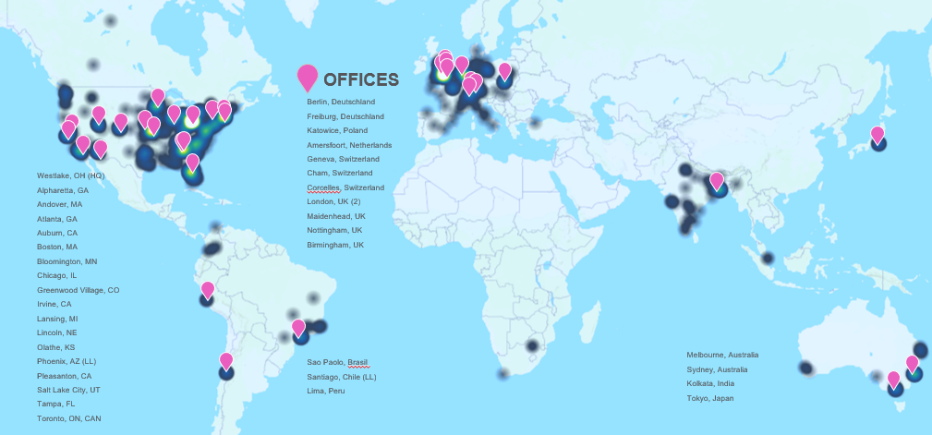
WHERE WE ARE - 4,000 EMPLOYEES
Notes:
Here’s a better glimpse of where our 4,000 employees are located. We have offices all over the world including California, the United Kingdom, Boston, Switzerland, Chicago, India, Peru, Australia and even Japan!

Slide 10
02
WHO WE ARE
Hyland’s Company Culture
Notes:
Does anyone have any questions about any of that before we move on?
If you’ve heard of Hyland before, chances are you may have heard about our company culture and how great it is to work here. I’m going to talk about some of the things that makes it so great.

Slide 11
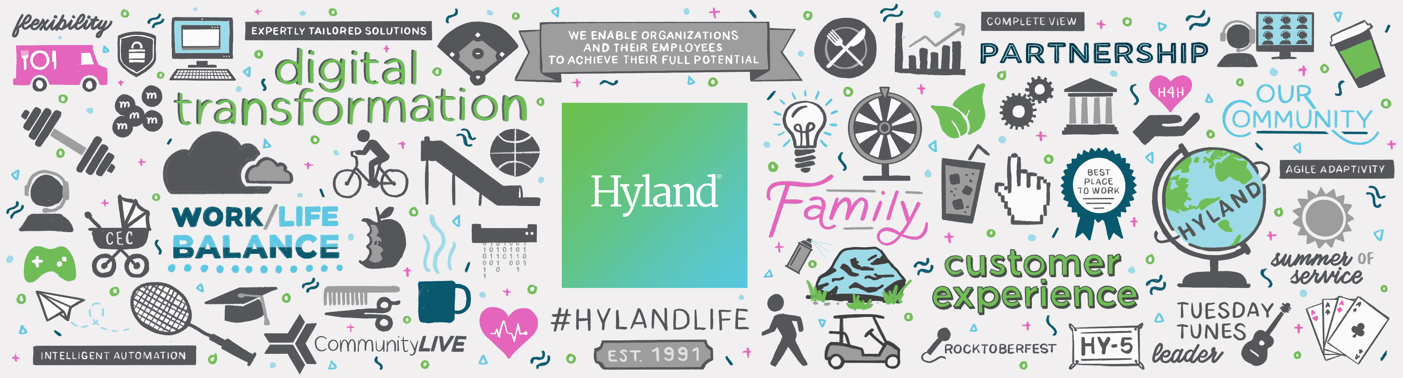
CULTURE
Notes:
Hyland has an employee-centric culture. Basically what that means it that Hyland cares about us, they care about our wellbeing and they want to offer as many ways for them to show they care as well as ways for employees to be able to give back to communities and organizations they care about.
I know most of you are ways away from working full-time jobs, but this is something you’ll really want ot look for when you’re job searching in the future. You want to work for a company that cares about you!
Support for healthy work-life balance
Onsite daycare for those employees with children
Exercise facilities
Wellness Center
Salons, dry cleaning, car washes, etc.
Sabbatical program – which means you’re able to take a whole month off work to explore hobbies, relax and have fun!
Hyland also offers opportunities for us to give back to the community:
12-hours volunteer time off (VTO)
Hylanders for Hylanders program (employee-driven donations to support fellow employees in times of need)
Employee engagement and appreciation
Welcome to Work Day, Employee Appreciation Day, food trucks, etc.
Career development

Slide 12
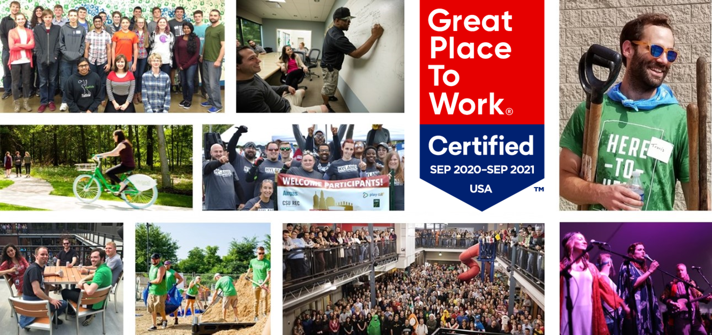
A PICTURE IS WORTH A THOUSAND WORDS
Notes:
Some fun pictures of Hylanders for you!
Hyland has been recognized as one of the 100 Best Companies to Work For by Fortune and Great Place to Work® six times.
Certified as a Great Place to Work for 2020-2021
During the work day we have two 20 minute paid breaks- it lets us get away from our desk and our work and refresh! We have things like an Arcade Room where employees can spend their breaks playing video games and hanging out! A Nintendo Switch, arcade games, ping pong tables and even a free soda fountain!
You can see in the pictures we have bikes that employees can use to ride around form building to building, we even have a big slide just for fun in the middle of the office!
We definitely have a “work hard play hard mentality” when it comes to work! We do put in a lot of work, but we do it with people who care about us and that we care for too. It’s great!
What do you think your favorite part would be if you worked at Hyland?

Slide 13
03
HOW DO YOU FIT IN?
Tech Outreach & Career Opportunities @ Hyland
Notes:
Does anyone have any questions about any of that before we move on?
Now I’d like to talk about how you could fit in at Hyland now, or even in the future. We’ll start with our tech outreach programs that are free for middle school and high school students.

Slide 14
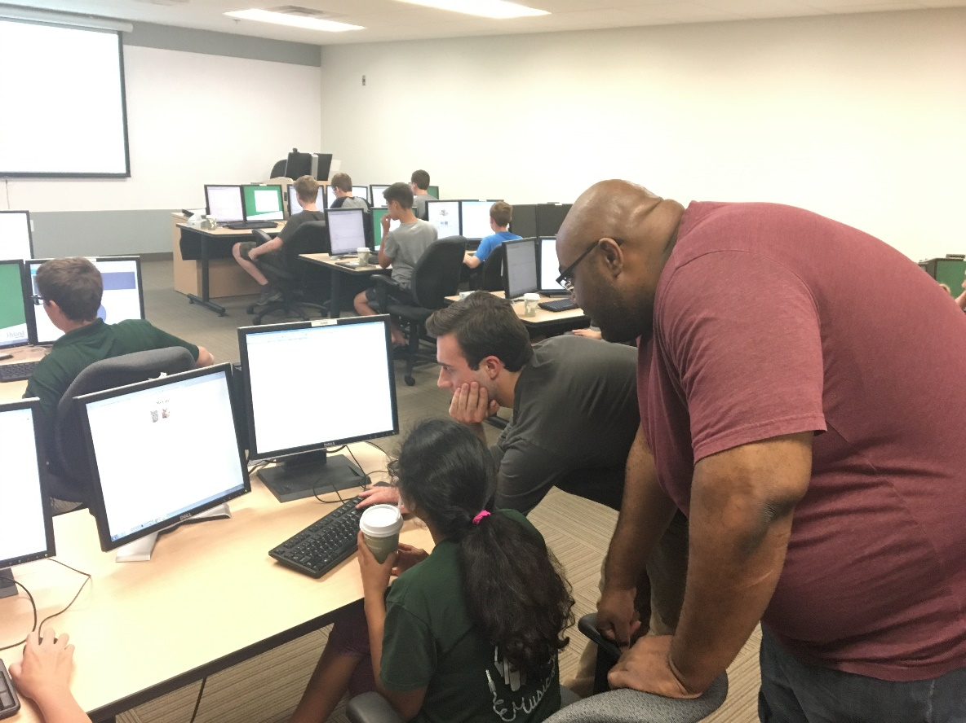
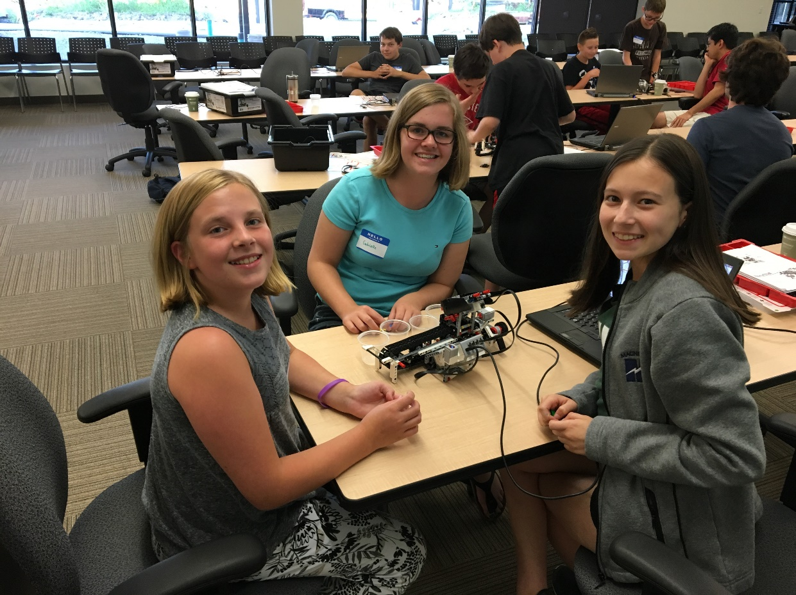
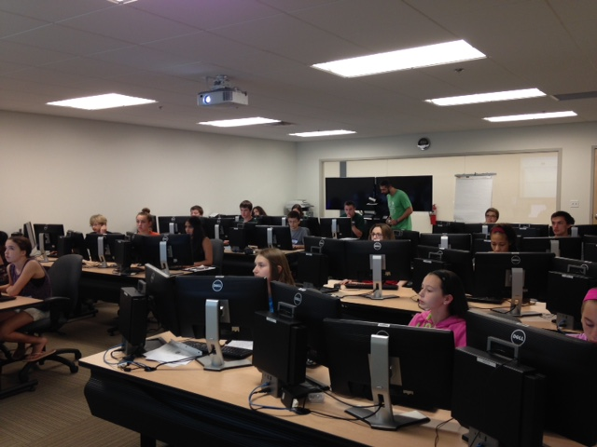
HY-TECH CAMPS
Notes:
One of my favorite programs that we do are Hy-Tech Camps!
Hy-Tech Camps are for students in grades 7-12
Have any of you participated in a Hy-Tech Camp before?
Most of these camps happen throughout the summer, but we’re starting to add some throughout the school year
These are held in the evening and are designed to be more of a broad introduction to a technology topic. Here are some fun camps we did virtually this summer:
Building Webpages
Data Scientists: Detectives of the Future
Programming with Python
Creating Retrogames with MakeCode Arcade
And Creating Interactive Stories with Twine

Slide 15
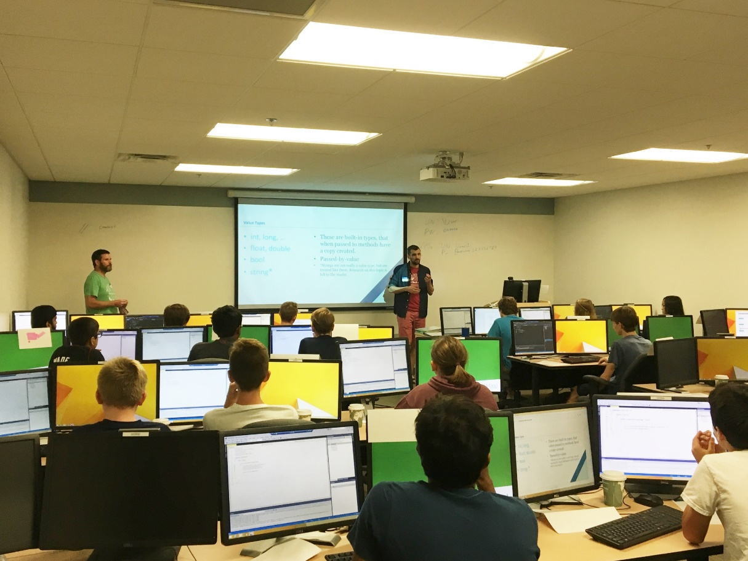
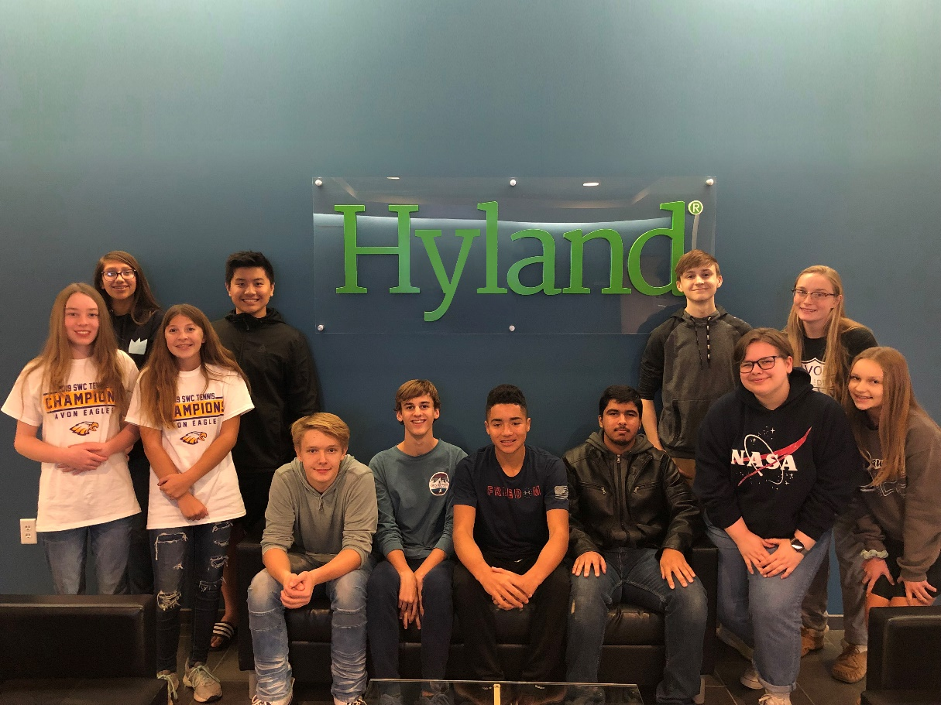
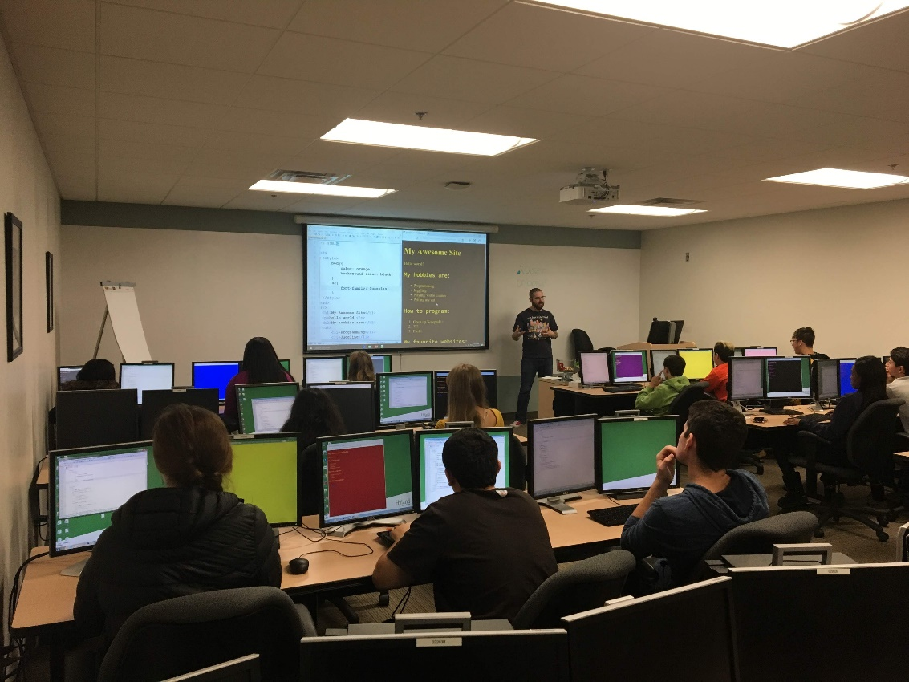
HY-TECH CLUB
Notes:
The club is a weekly after school program for high school students- something to look forward to!
All students apply to get in and the club is based on curriculum developed by Hyland.
We’ve taught various programming languages over the past few years:
HTML, CSS & JavaScript, Web Development and Python!
12 week semester commitment, meetings are once a week from 5-7:30PM and are currently being held virtually via Zoom.

Slide 16
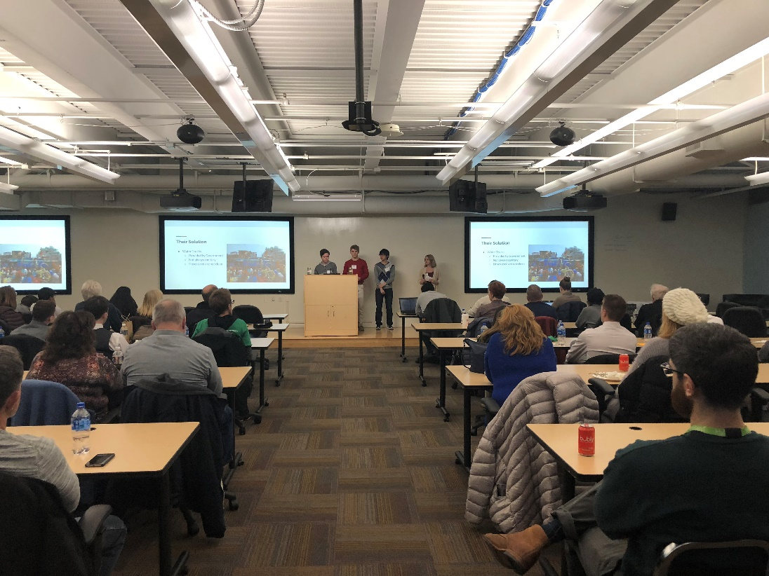
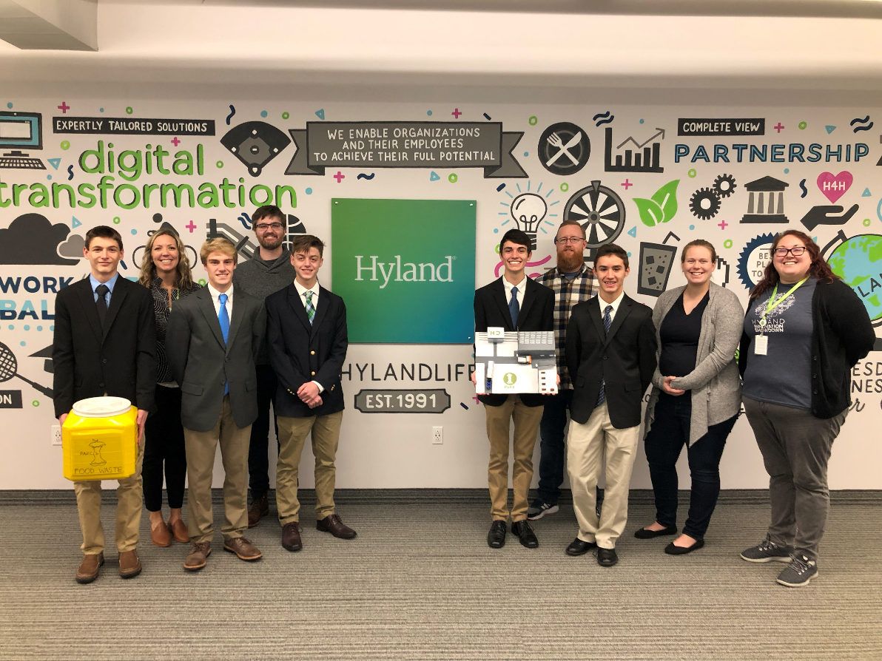
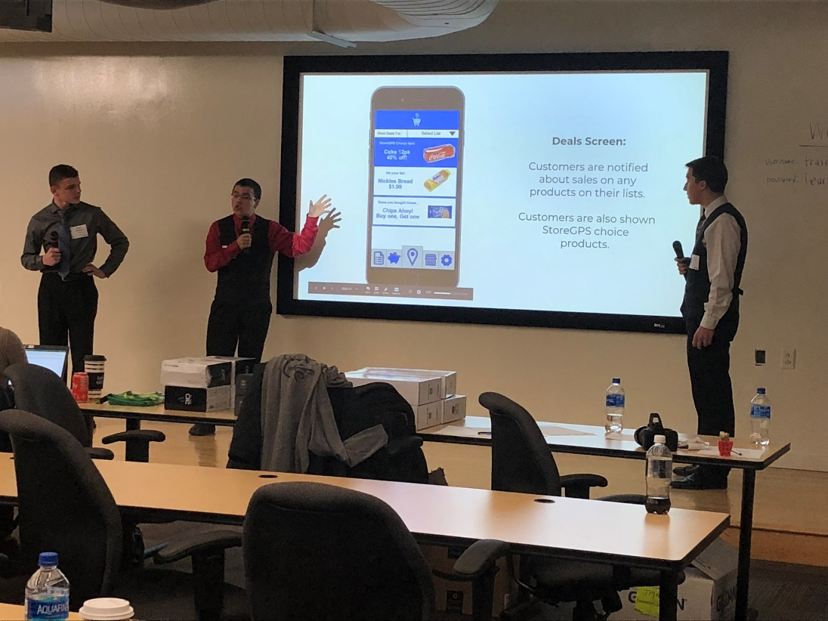
HIGH SCHOOL INNOVATION SHOWDOWN
Notes:
The Innovation Showdown is an annual competition between teams of high school students
We task these teams to come up with an innovative idea that solves some kind of real-life problem
All teams who are accepted into the competition are paired up with a Hyland Mentor who help them with their project along the way.
The teams who make it to the Final Round come to Hyland to pitch their idea in person to a panel of judges
Prizes awarded to the top 3 teams, and each member of the 1st place team receives a $500 scholarship

Slide 17
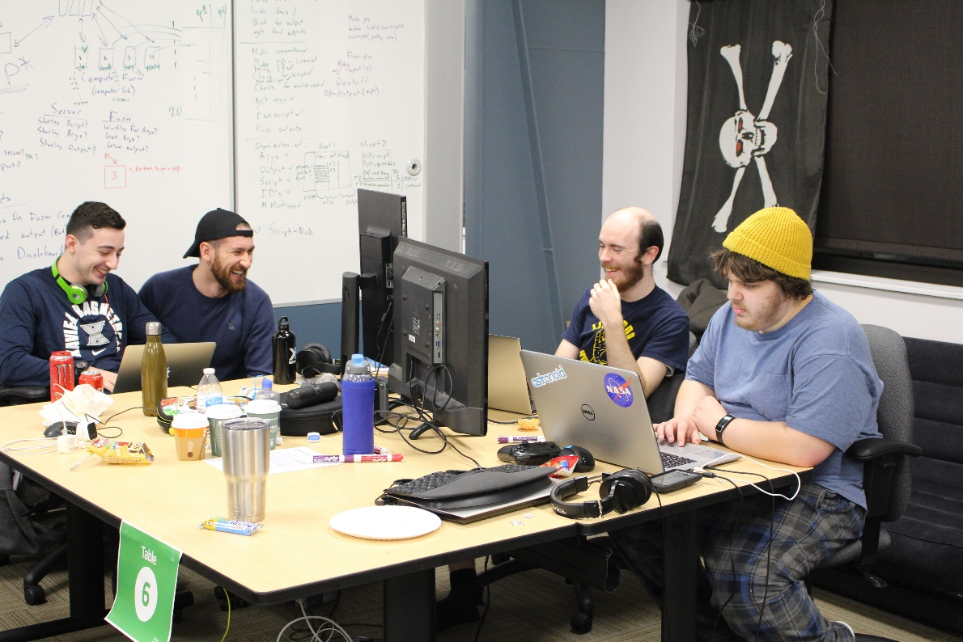
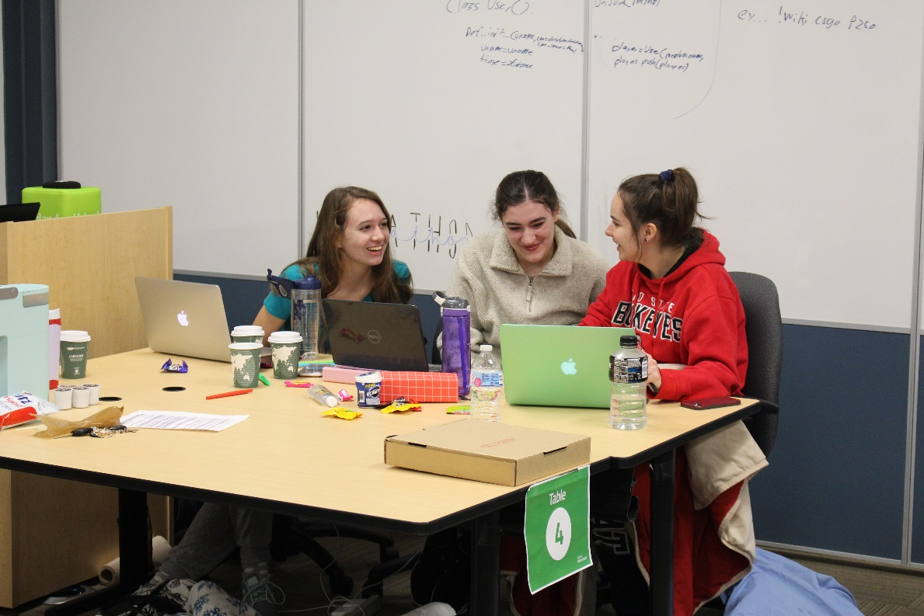
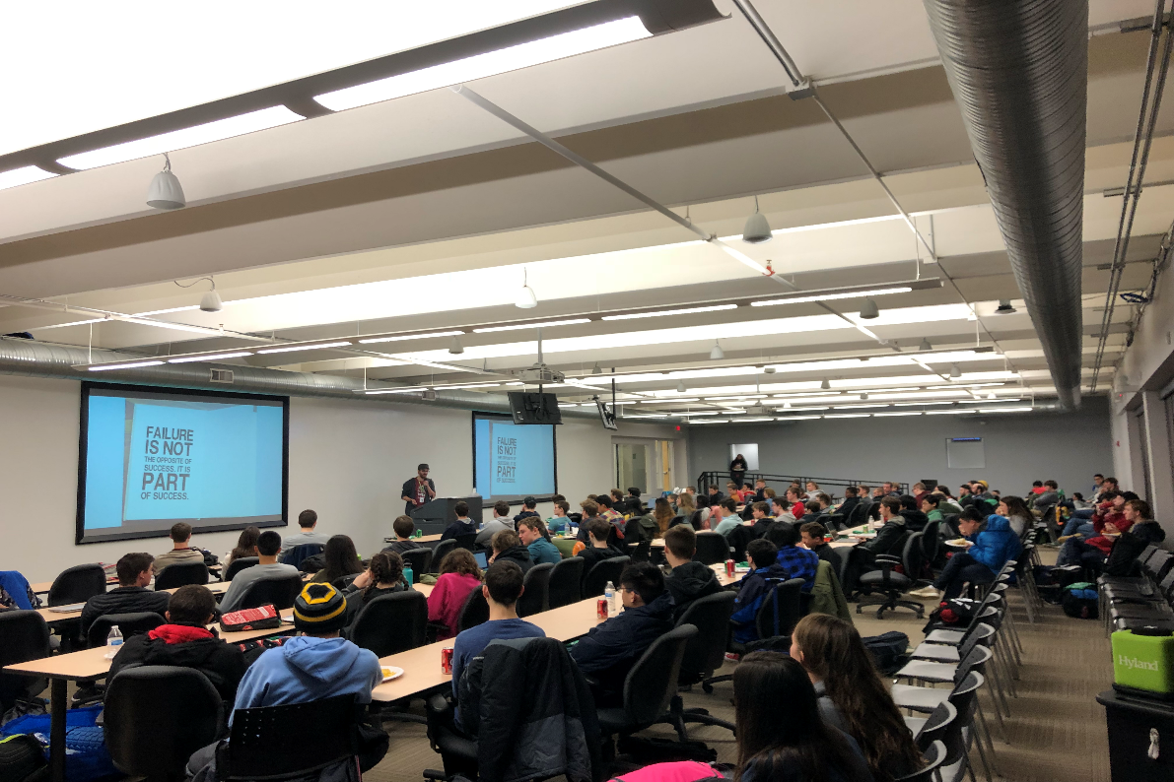
HYLAND HACKATHON
Notes:
This is an event for High School and College Students
It’s an event where students spend the entire weekend from Friday evening to Sunday afternoon at Hyland’s Headquarters
Our past Hackathon actually took place completely virtually on Zoom- we had students join us from all over which was a really cool experience for both them and for us!
This is more of a technical competition and the teams are tasked to come up with a prototype from scratch over the weekend
Prizes awarded to the top teams
Does anyone have any questions about our tech outreach programs?

Slide 18
THANKS!
DO YOU HAVE ANY QUESTIONS?
techoutreach@hyland.com

